Slide 1
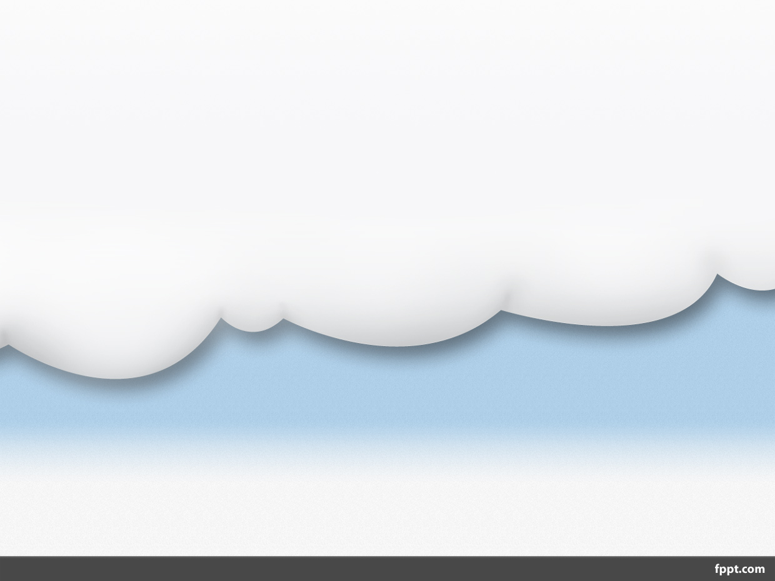
Cloud Computing
-- The New Age Of Computing

Slide 2
Outlines
Introduction
What is Cloud Computing
Why Cloud Computing?
Cloud Architecture
Cloud Service Models
Cloud Storage
Advantages
Disadvantages
Conclusion

Slide 3
Introduction
With traditional desktop computing, we run copies of software programs on our own computer. The documents we create are stored on our own pc.
Although documents can be accessed from other computers on the network, they can’t be accessed by computers outside the network. This is PC-centric.
With cloud computing, the software programs one use aren’t run from one’s personal computer, but are rather stored on servers accessed via the Internet.

Slide 4
If a computer crashes, the software is still available for others to use. Same goes for the documents one create; they’re stored on a collection of servers accessed via the Internet.
Anyone with permission can not only access the documents, but can also edit and collaborate on those documents in real time.
Unlike traditional computing, this cloud computing model isn’t PC-centric, it’s document-centric.

Slide 5
What Is Cloud Computing
Cloud computing is a type of computing that relies on sharing computing resources rather than having local servers or personal devices to handle applications.
In cloud computing, the word cloud (also phrased as "the cloud") is used as a metaphor for "the Internet," so the phrase cloud computing means "a type of Internet-based computing," where different services such as servers, storage and applications are delivered to an organization's computers and devices through the Internet.
Cloud computing is comparable to grid computing, a type of computing where unused processing cycles of all computers in a network are harnesses to solve problems too intensive for any stand-alone machine.

Slide 6
Why Cloud Computing?
Cloud Computing Is User Centric
Cloud Computing Is Task-Centric
Cloud Computing Is Powerful
Cloud Computing Is Accessible
Cloud Computing Is Intelligent
Cloud Computing Is Programmable

Slide 7
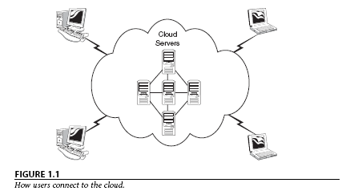
Cloud Architecture
Individual users connect to the cloud from their own personal computers or portable devices, over the Internet. To these individual users, the cloud is seen as a single application, device, or document. The hardware in the cloud (and the operating system that manages the hardware connections) is invisible.

Slide 8
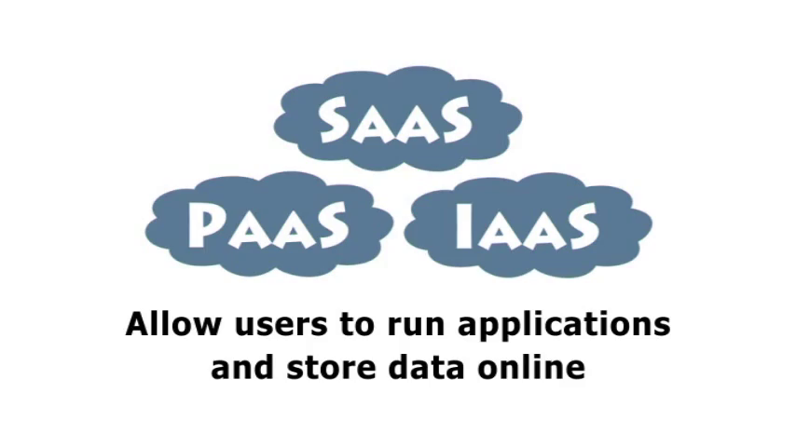
Cloud Service Models
There are mainly 3 service models given as:
1. Software as a Service (SaaS)
2. Platform as a Service (PaaS)
3. Infrastructure as a Service (IaaS)

Slide 9
SaaS
Defined as service-on-demand, where a provider will license software tailored.
In the SaaS model, cloud providers install and operate application software in the cloud and cloud users access the software from cloud clients. Cloud users do not manage the cloud infrastructure and platform where the application runs. This eliminates the need to install and run the application on the cloud user's own computers, which simplifies maintenance and support.
Examples of SaaS include: Google Apps, Microsoft Office 365, Onlive, GT Nexus, Marketo, and TradeCard.

Slide 10
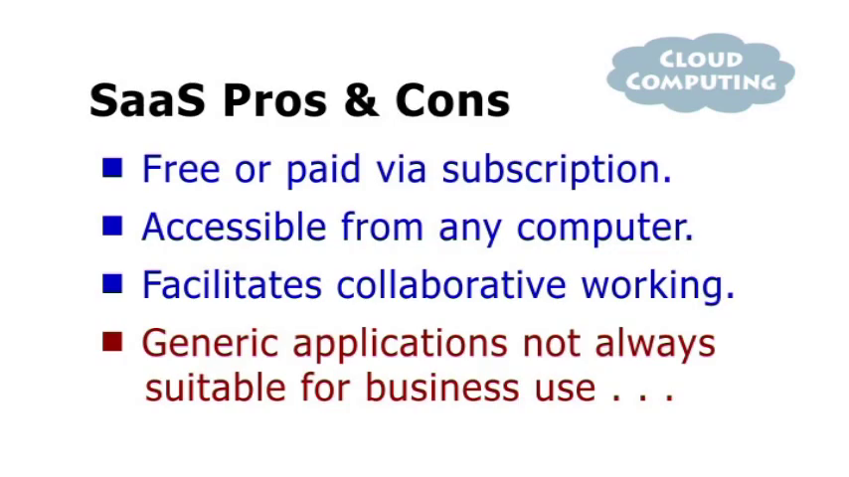

Slide 11
PaaS
In the PaaS model, cloud providers deliver a computing platform typically including operating system, programming language execution environment, database, and web server. Application developers can develop and run their software solutions on a cloud platform without the cost and complexity of buying and managing the underlying hardware and software layers.
Examples of PaaS include: AWS Elastic Beanstalk, Cloud Foundry, Heroku, Force.com, EngineYard, Mendix, OpenShift, Google App Engine, Windows Azure Cloud Services and OrangeScape

Slide 12
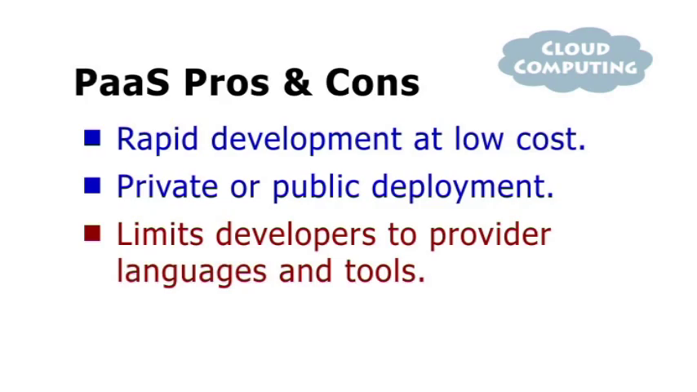

Slide 13
IaaS
In the most basic cloud-service model, providers of IaaS offer computers physical or (more often) virtual machines and other resources. IaaS clouds often offer additional resources such as a virtual-machine disk image library, raw (block) and file-based storage, firewalls, load balancers, IP addresses, virtual local area networks (VLANs), and software bundles.^{[49]} IaaS-cloud providers supply these resources on-demand from their large pools installed in data centers.
Examples of IaaS providers include: Amazon EC2, Azure Services Platform, DynDNS, Google Compute Engine, HP Cloud, iland, Joyent, LeaseWeb, Linode, NaviSite, Oracle Infrastructure as a Service, Rackspace Cloud, ReadySpace Cloud Services, ReliaCloud, SAVVIS, SingleHop, and Terremark

Slide 14
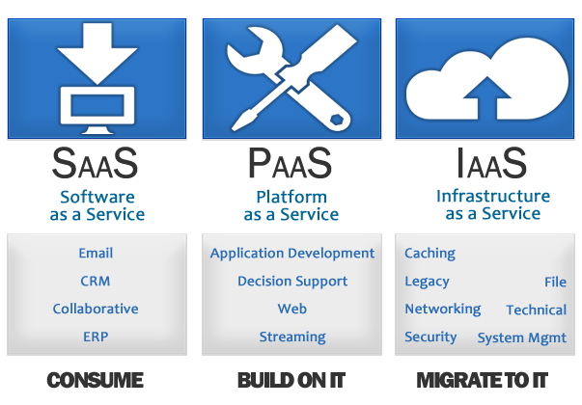

Slide 15
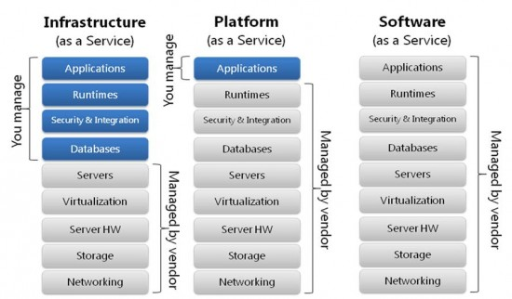

Slide 16










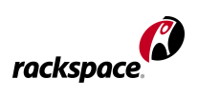



Some Cloud Service Providers
Utility Computing
Platform as a Service (PaaS)
Cloud-based User Applications

Slide 17
Cloud Storage
Cloud storage means "the storage of data online in the cloud," wherein a company's data is stored in and accessible from multiple distributed and connected resources that comprise a cloud.
Cloud storage can provide the benefits of greater accessibility and reliability; rapid deployment; strong protection for data backup, archival and disaster recovery purposes; and lower overall storage costs as a result of not having to purchase, manage and maintain expensive hardware. However, cloud storage does have the potential for security and compliance concerns.

Slide 18
Types of Cloud Storage
Public Cloud
Private Cloud
Hybrid Cloud

Slide 19
Public Cloud
A form of cloud storage where the enterprise and storage service provider are separate and the data is stored outside of the enterprise's data center. With public cloud storage, or external storage clouds, enterprises and small businesses offload their data storage and archival / backup needs to a third-party cloud storage service provider, freeing them from the expensive costs of having to purchase, manage and maintain on-premises storage hardware and software resources

Slide 20
Private Cloud
The phrase used to describe a cloud computing platform that is implemented within the corporate firewall, under the control of the IT department.
A private cloud is designed to offer the same features and benefits of public cloud systems, but removes a number of objections to the cloud computing model including control over enterprise and customer data, worries about security, and issues connected to regulatory compliance

Slide 21
Hybrid Cloud
A combination of public cloud storage and private cloud storage where some critical data resides in the enterprise's private cloud while other data is stored and accessible from a public cloud storage provider.
Hybrid cloud storage combines the advantages of scalability, reliability, rapid deployment and potential cost savings of public cloud storage with the security and full control of private cloud storage.

Slide 22
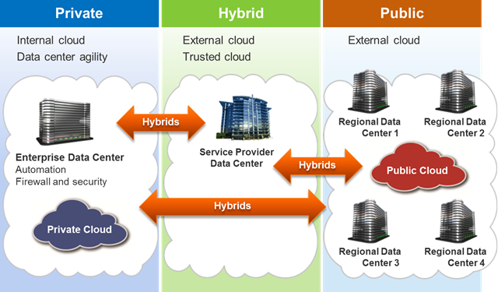

Slide 23
Advantages
Lower computer costs.
Improved performance.
Reduced software costs.
Instant software updates.
Improved document format compatibility.
Unlimited storage capacity.
Increased data reliability.
Universal document access.
Latest version availability.
Device independence.

Slide 24
Disadvantages
Requires a constant Internet connection.
Does not work well with low-speed connections.
Features might be limited.
Can be slow.
Stored data might not be secure.
Stored data can be lost.

Slide 25
Conclusion
Thus cloud computing provide a super-computing power .
This cloud of computers extends beyond a single company or enterprise.
The applications and data served by the cloud are available to broad group of users, cross-enterprise and cross-platform.

Slide 26

Q
U
E
R
I
E
S
?

